Slide 1

LaunchCode Liftoff
Class 3
Hank DeDona
4/20/20

Slide 2
“No one in the brief history of computing has ever written a piece of perfect software. It's unlikely that you'll be the first.” - Andrew Hunt

Slide 3
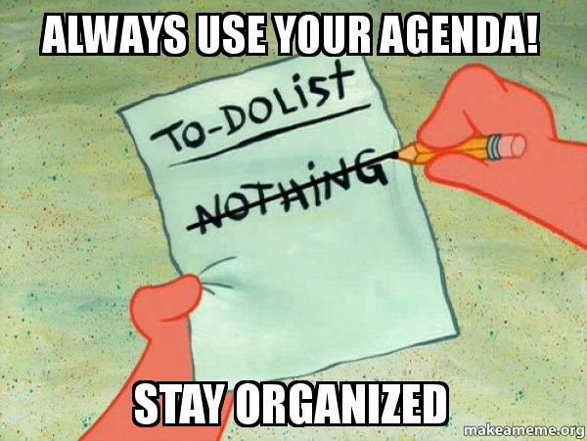
Agenda
Objectives and Timeline
Lecture
Git Workflows
Licensing
Open Source
Personal Branding
Introduce Assignments
Review Objectives
Activity
Stand-Up
Resume Workshop

Slide 4

Objectives
Understand Intellectual Property & Software Licensing
Know How to Include a License
Know What Makes a Good Technical Resume
Utilize LinkedIn to Network with Other Professionals
Know How to Use Your GitHub Account to Showcase Projects

Slide 5
Timeline Review
Capstone Project Selected
Initial Features
Class 1
Class 3
Class 2
Class 4
Wireframes & User Stories
Project Review 1

Slide 6

giting Into the Flow of Things
Git Workflows

Slide 7




VCS
Version Control Systems
Track changes to documents
AKA Source Control
git is popular, but many alternatives

Slide 8

GitHub
git as a service
Provides git plus management tools

Slide 9

GitHub Flow
How git can help collaboration
Just one example of many git flows
guides.github.com/introduction/flow

Slide 10
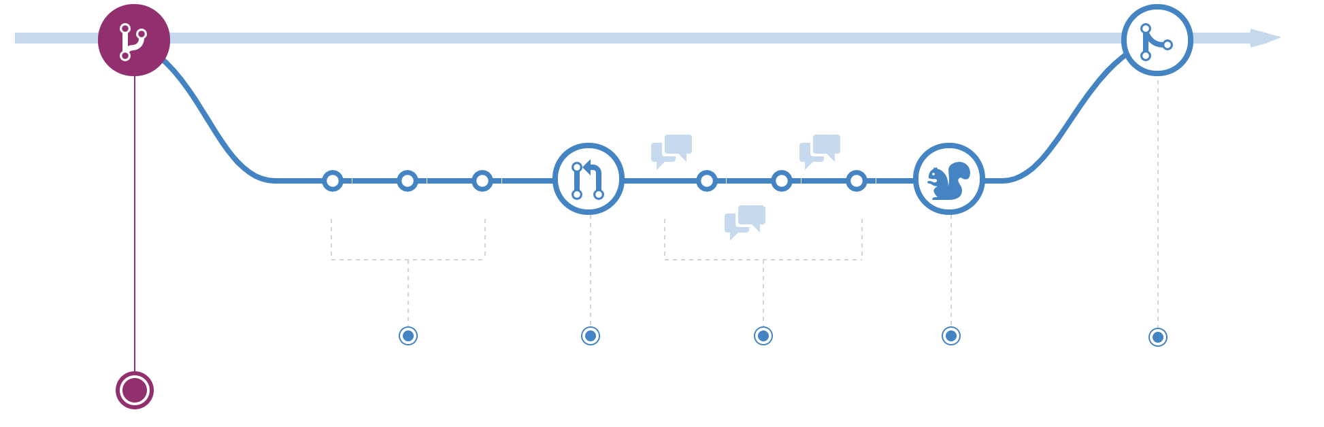
Create a Branch

Slide 11
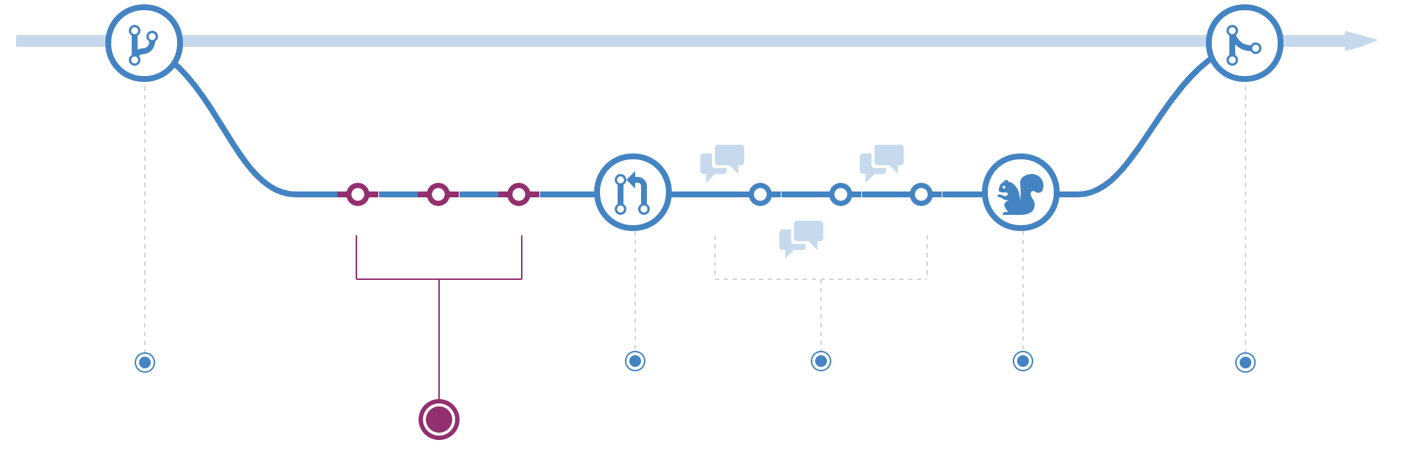
Add Commits

Slide 12
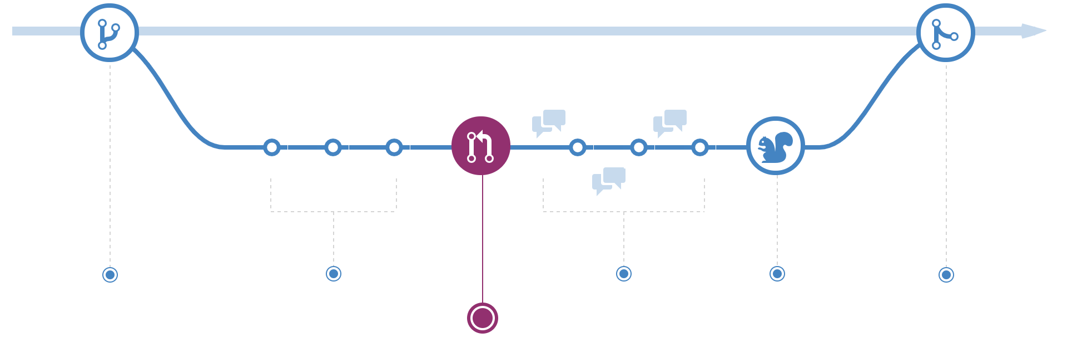
Open a Pull Request

Slide 13
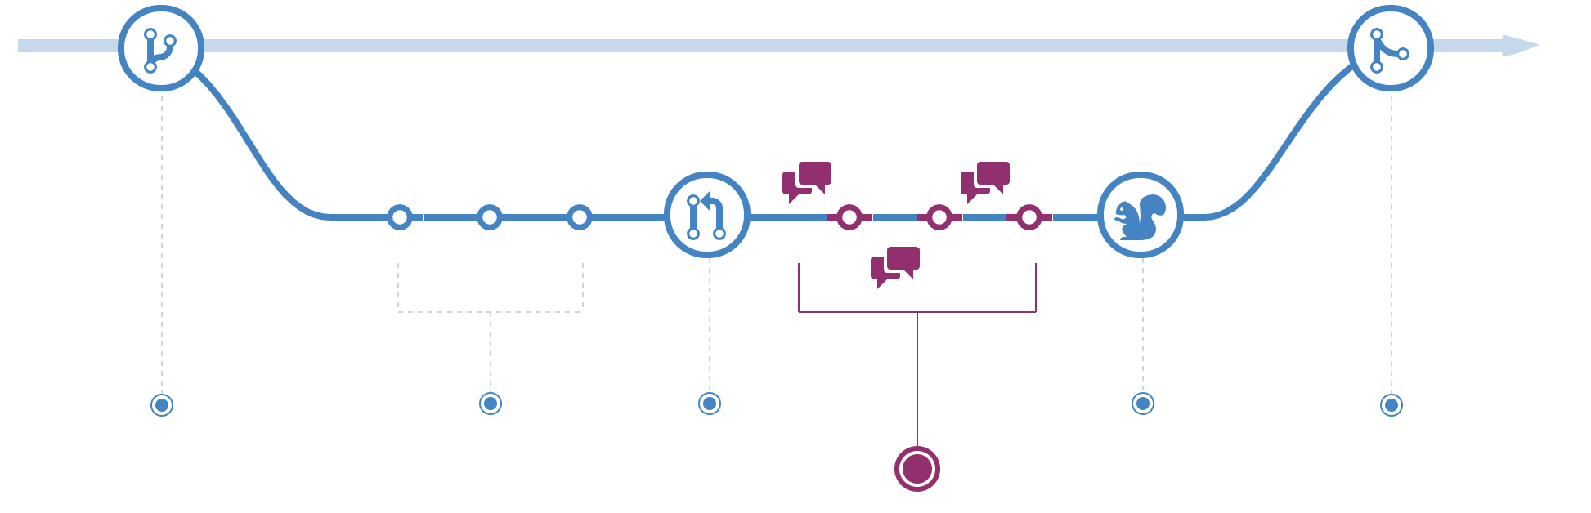
Discuss and Review Code

Slide 14

Deploy*

Slide 15
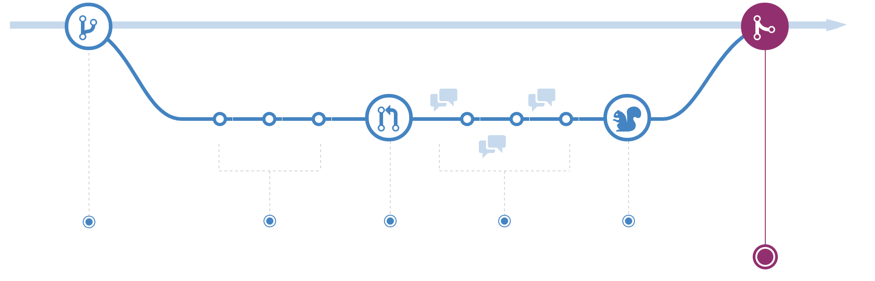
Merge

Slide 16
Intellectual Property

Slide 17

Your Property Rights and You!
You Own Your Code
Sell It (Work)
Give it (Open Source)
Do Neither (Own It)
Employer IP Contract

Slide 18

Licensing
https://choosealicense.com/
Common Questions
Should I include a license?
What license should I choose?
What If I don’t include a license?
What about code I copy/paste from Stack Overflow?
Even loops or common patterns?
Notes:
SO: Creative Commons - You really shouldn’t re-use :D https://stackoverflow.com/help/licensing
You still have exclusive copyright over GitHub code you’ve pushed

Slide 19

Open Source
Give Back to the OSS Community
In-depth Learning
Great Resume Fodder
http://www.firsttimersonly.com/
https://opensourcefriday.com/
Most of Your Tools and Libraries are OSS!

Slide 20
Personal Branding
Notes:
Advocate for personal branding
Build networks, know what’s hot, get new jobs, never settle

Slide 21
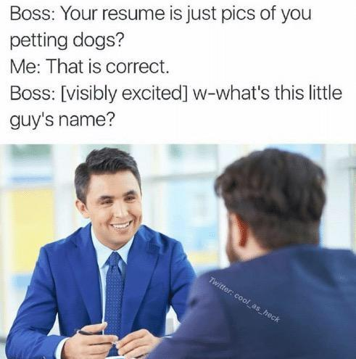
Technical Resumes
Have an Objective
List Technical Skills
Highlight Your Strengths
Use Action Words & Concrete Results
Tailor Your Resume
KISS (Keep It Simple, Stupid)
List LaunchCode LC101 & Liftoff
Notes:
Prep Work Example https://education.launchcode.org/liftoff/articles/technical-resume/
My Resume: https://drive.google.com/file/d/0Bx04Qd46sWDgdjVZOWlFUUd1QmM/view?usp=sharing

Slide 22

LinkedIn
Summary - Tell a Story!
Projects - Highlight Features
Education - LaunchCode \o/
Skills
Volunteering
Accomplishments

Slide 23

GitHub Profile
Professional Name and Picture
Star Your Best Projects

Slide 24

GitHub Projects
Clear Names
Self-Contained
Clean Up Cruft
Common Files to Include:
README.md
Create a README
Mastering GitHub Markdown
License.txt
.gitignore

Slide 25

Online Communities
LaunchCode Community & Alumni
Meetup: https://www.meetup.com/
Twitter
Hacker News: https://news.ycombinator.com/
Reddit
Menteaship www.menteaship.com
Share Your Favorites in #general
Notes:
How do I keep up (know what to know)?
Networking!? Business cards!
Make connections, ask questions, find what excites you, it’s a big world

Slide 26
Recap
Tonight’s Objectives:
Understand Intellectual Property & Software Licensing
Know How to Include a License
Know What Makes a Good Technical Resume
Utilize LinkedIn to Network with Other Professionals
Know How to Use Your GitHub Account to Showcase Projects

Slide 27
Assignments

Slide 28
Assignment - Project Setup
https://education.launchcode.org/liftoff/modules/assignments/project-setup.html#assignment-project-setup
Push Existing Work
Update your `liftoff-assignments` repo to link to your new repo
Submit the assignment on Canvas with the above URL

Slide 29
Assignment - Online Profiles
https://education.launchcode.org/liftoff/modules/assignments/online-profiles.html#assignment-online-profiles
Update README.md
Resume (PDF)
GitHub
LinkedIn
Update your `liftoff-assignments` repo to link to profiles
Submit the assignment on Canvas with the above URL
Notes:
If you’re not comfortable uploading a resume, work with mentor
Ditto for LinkedIn or GitHub

Slide 30
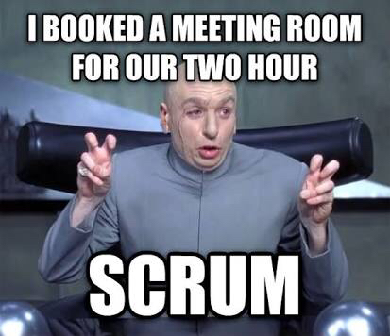
Activity - Scrum (15 mins)
~1 Minute Per Person
What You Did
What You’re Working On Next
Any Blockers
Notes:
Ableist, but the idea is that it’s short. If it works better sitting, please do.

Slide 31

Resume
Create a rough outline
Fill in Technical Details and Education
Add Work History
Edit and Review
Review with Group Member
Mentor Feedback

